Slide 1
MICROSOFT CAMPUS CONNECT PROJECT

Slide 2
HOME AUTOMATION AND HOME SECURITY
- TEAM U

Slide 3
HOME AUTOMATION
A project on Home Automation and home security System that can be controlled via smart phones.
Home automation system which is a complete relief for the user who wishes to get up at a desired time.
The user will be asked to set an alarm, adding the task. All the arrangements including turning on of the lights, alarm buzzing, task notifications and coffee maker are set up automatically without the users intervention.

Slide 4
A Universal App is created which allows you to put timestamps on database, along with the choice of switching on of the lights and coffee maker.
This app is in the form of a calendar in which different events could be entered with a date and time according to which it will update the sensors so that a task could be performed.
This is where we would like to incorporate Microsoft's ideas of inter-operability and inter-connectivity and apply it to each and every devise.

Slide 5
Softwares and componeNts used
Microsoft Visual studio 2015
Microsoft azure
Arduino board with ethernet shield
Sensors
Raspberry pi 2 with raspbian
Openhab and mqtt

Slide 6
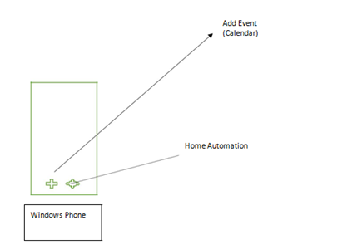
ARCHITECTURE

Slide 7
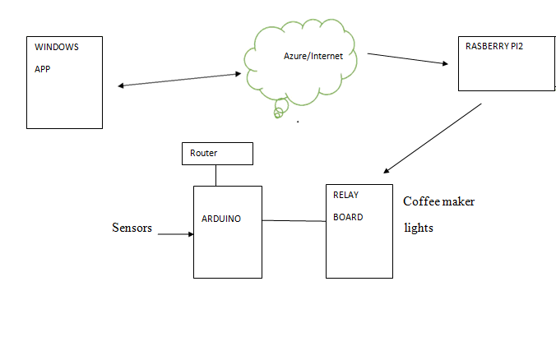
architecture

Slide 8
Used case:
Say we have a meeting to attend at 9 am.
Time for alarm and task is added in the app.
It will connect to the coffee maker and start boiling water well about 15 minutes before hand .
If chosen the option of switching on the lights, lights will switch minutes before the waking time.
Alarm rings to notify the user at the particular time.

Slide 9
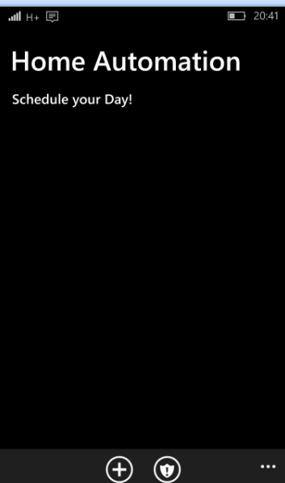
Snapshots of the app

Slide 10
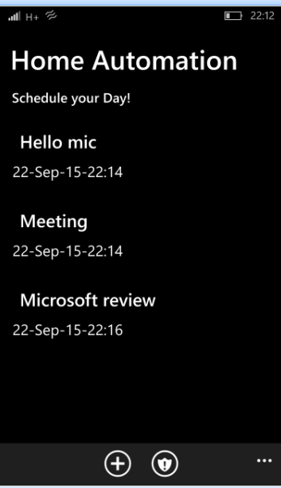
Snapshots of the app

Slide 11
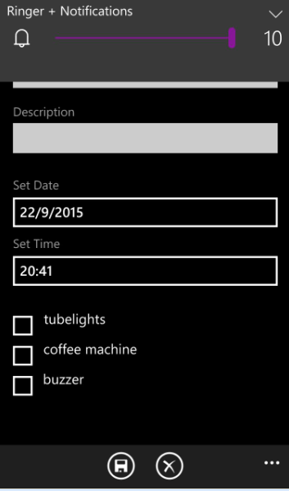
Snapshots of the app

Slide 12
Azure is used to achieve two things:
For receiving data from Universal App, processing it and sending the corresponding signals to Raspberry pi2.
For collecting the readings of the sensors in a continuous manner and sending the same to the app in the form of pop-ups or notifications.
These two things were achieved using the Service Bus, Azure Database, Stream Analytics and Event Hubs feature of Azure.

Slide 13
Home security using open hab
Openhab is a software for integrating different home automation systems and technologies into one single solution.
Openhab is connected to various sensors by means of Mqtt,which is a machine-to-machine (M2M)/"Internet of Things" connectivity protocol.

Slide 14
Features of this system
Temperature / Humidity sensor:
User can access the app and check the temperature and humidity in the house at any time.
Motion Sensor:
Used as a security sensor to monitor a room and set notification when it senses a moving body.

Slide 15
Smoke / Gas:
Used to send a notification when the sensor senses smoke, fire, or LP gas .
Water sensor:
Water Detection circuit senses if there is a water leak or overflow in the room and notifies accordingly.
sound sensor:
This circuit will check if there is any loud noise while the owner is away from home.

Slide 16
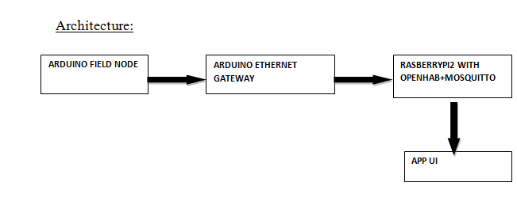
architecture

Slide 17
we look forward to connect devices and sensors and make them interact with one another in a way that will make our lives easier and more technology driven and make way for a smart home.

Slide 18
THANK YOU

